Slide 1
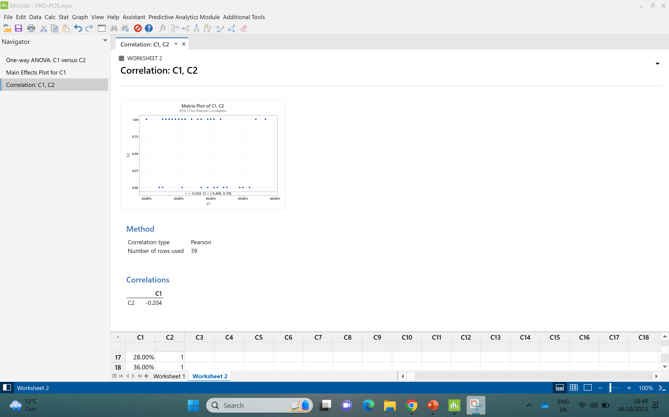
CORRELATION TEST

Slide 2

FINDINGS:
Firstly from the above findings, Centralized teams have a relation on the POS collection.
From the correlation test the correlation is negative this implies that
Ho:r=0; no correlation.H1:r$≠$0: there is correlation
So we infer that there is a weak relation of centralized teams in the collection of POS.
So therefore we reject the null hypothesis of no correlation.
Now we need to know whether the centralized teams impact the POS collection so for this we need to examine the POS payments and centralized teams with the help of simple linear regression test which is as follows:

Slide 3
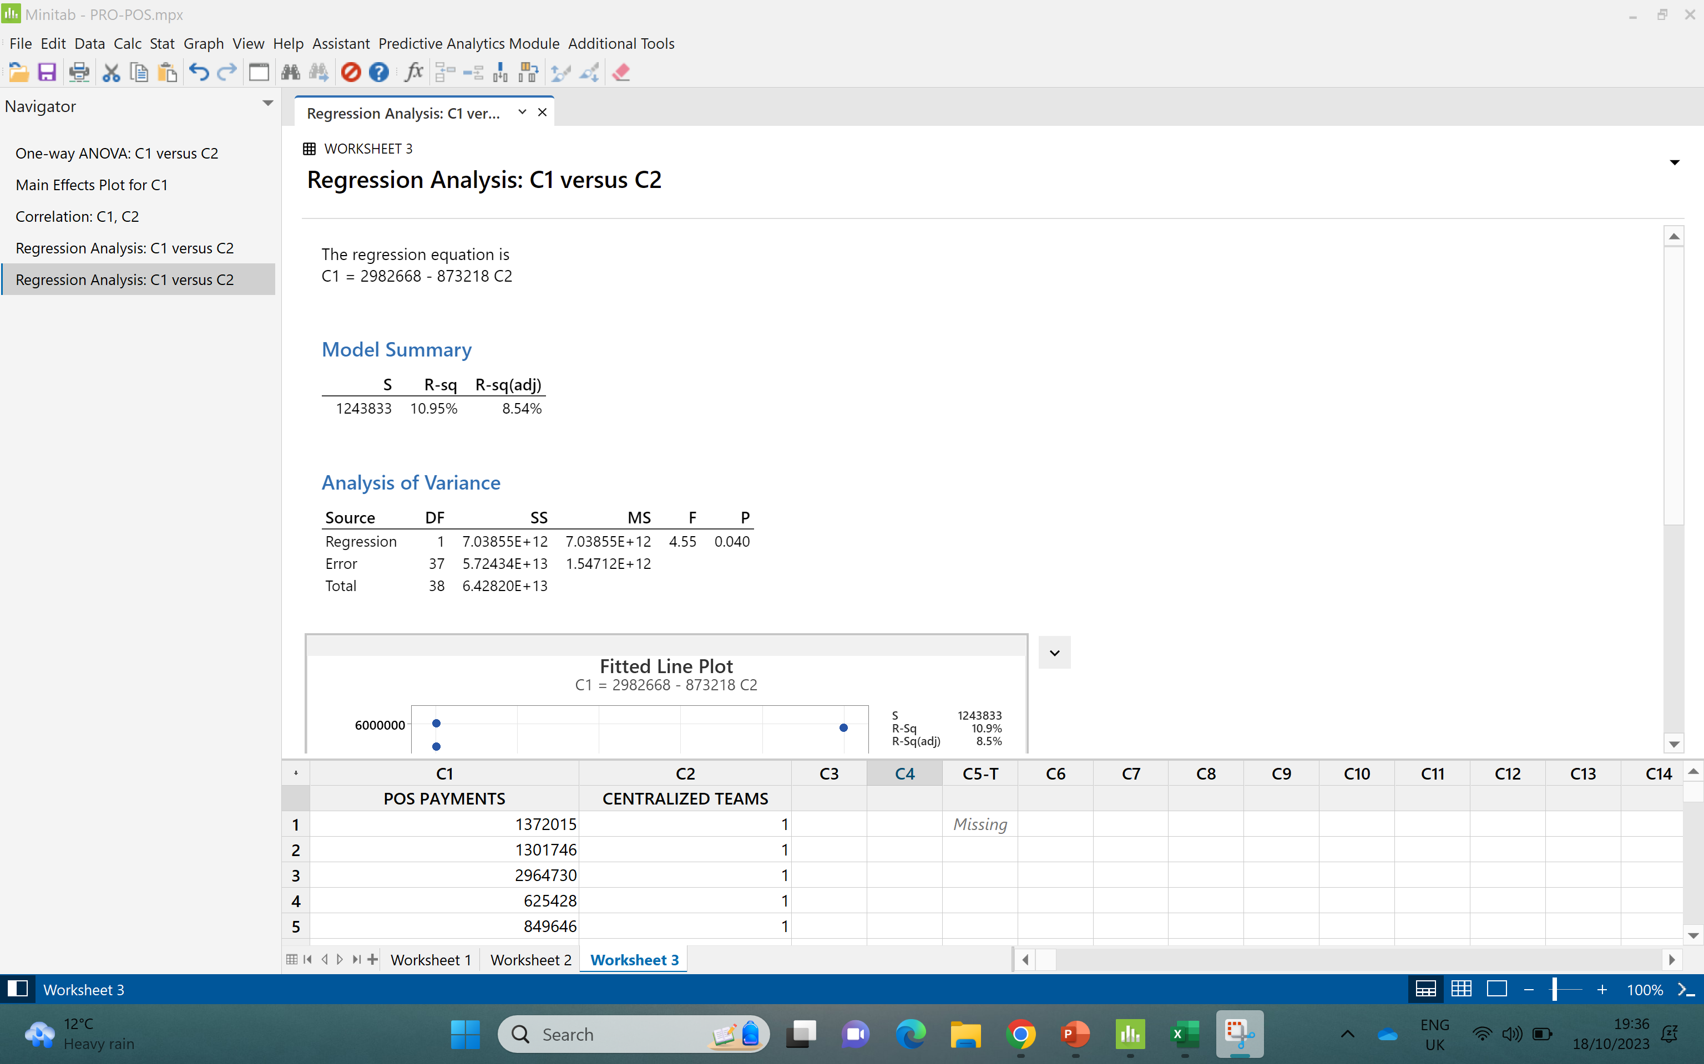

Slide 4
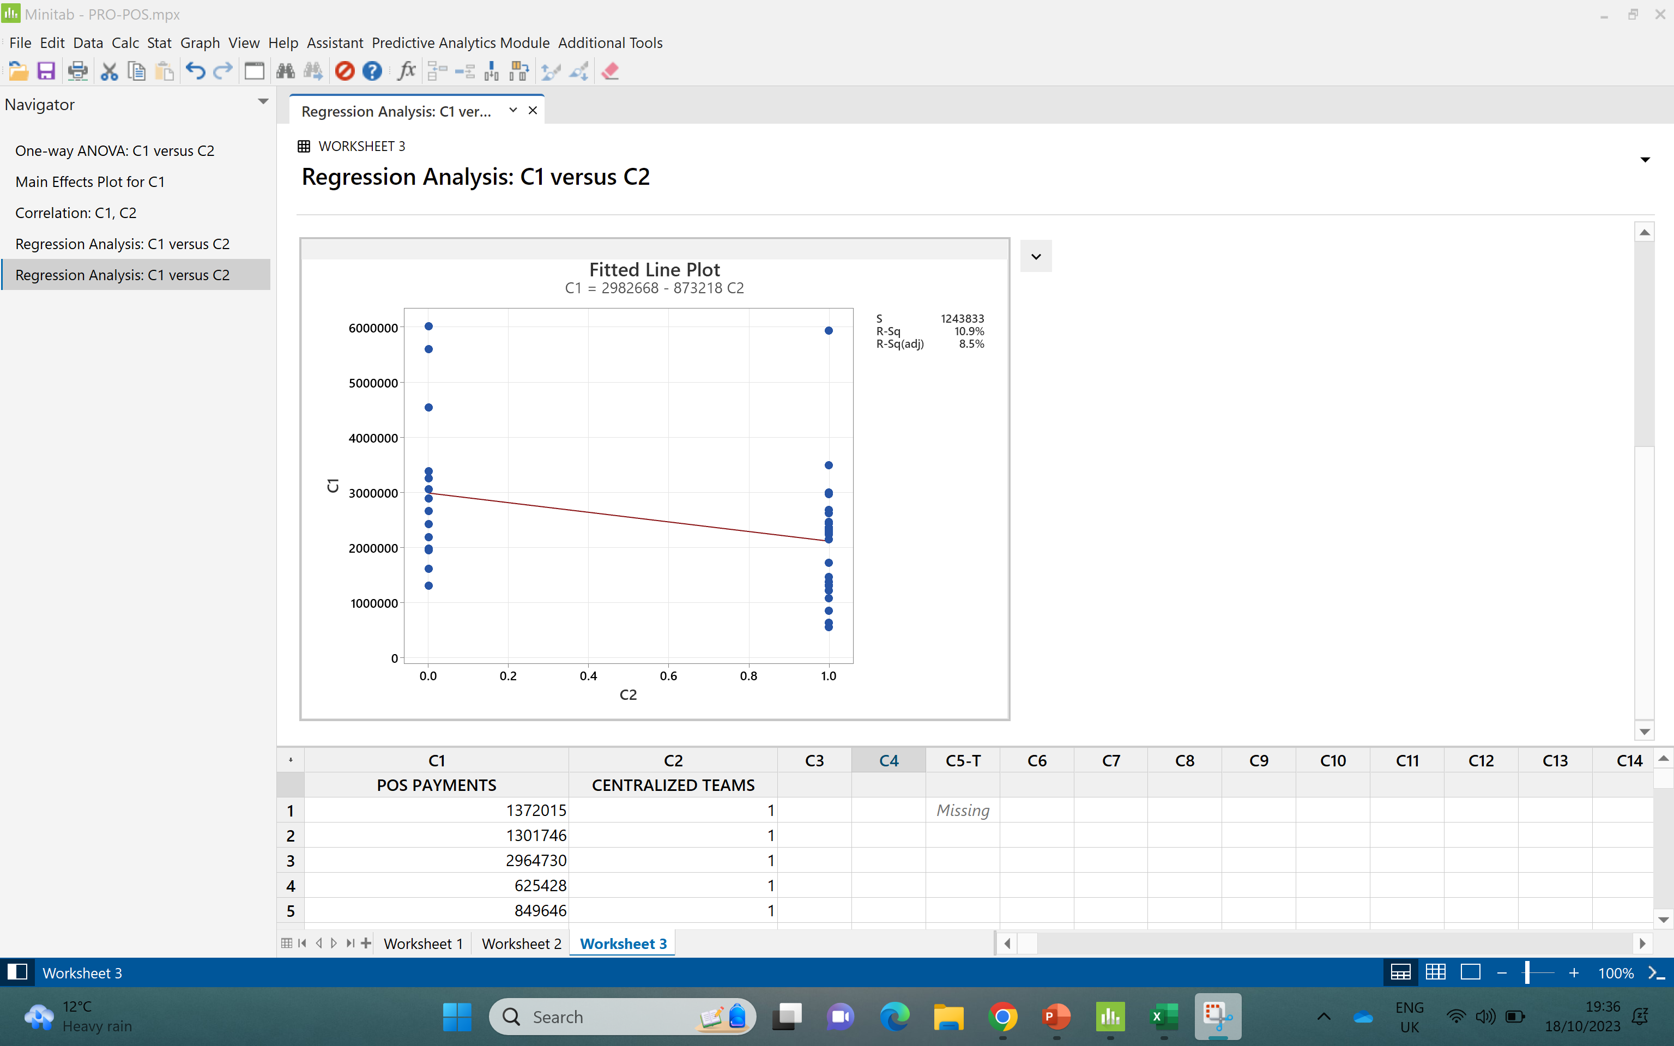

Slide 5
FINDINGS:
From the above Regression test and results we confirm that there is a relation between the POS collection and Centralized teams.
The Centralized teams do impact the POS collections.

Slide 6
Exercise 4:Solution Categories Based on the information provided, what could be the affinity categories for the key drivers that impact POS performance?
The affinity categories:
POS collection system
Patient Education
Policies
Tools to help estimate patient liabilities.

